Slide 1
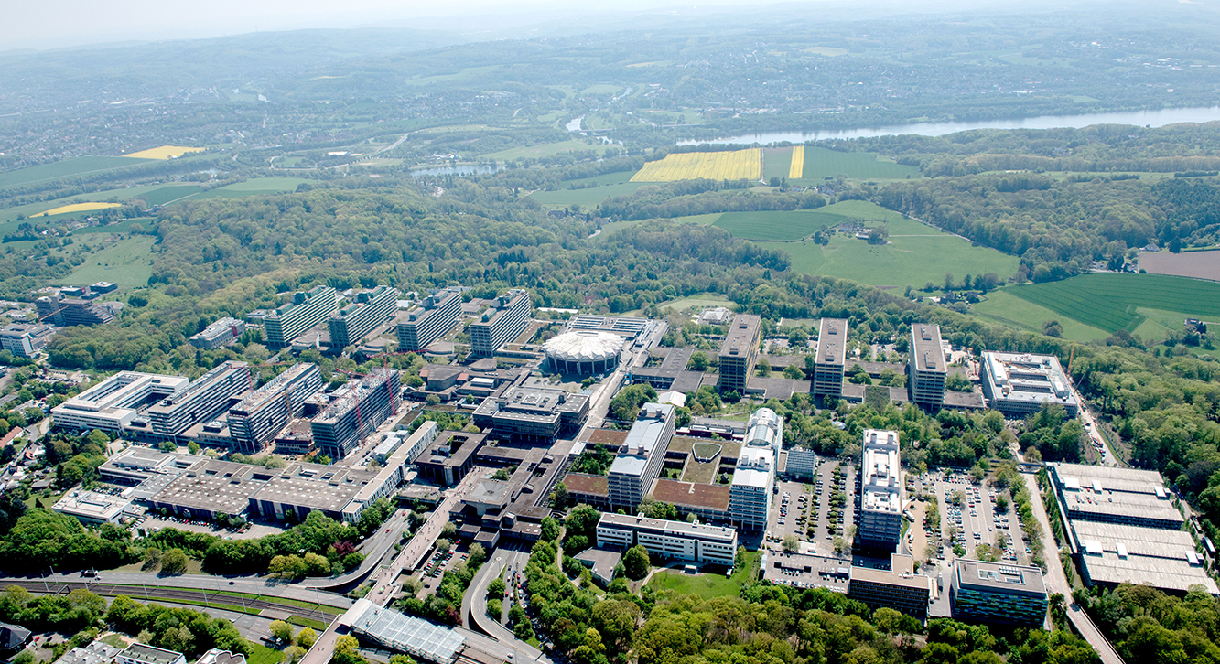

Hier Bild von Ausgabe einfügen
Perceptron Algorithm
Parallel Computing SS18
Lennard Flegel, Alexander Mardorf, Bajram Ibishi, Franziska Thiemann

Slide 2
Outline
The Perceptron learning Algorithm
What it does
How it does that
Why it works
Software architecture
Going Parallel
Our implementation
Benchmarking etc
In a perfect world
In a world without race conditions
In our world
Conclusion
OPM JAVA
Sources

Slide 3
The Perceptron Learning Algorithm (PLA)

Slide 4


Supervised Learning
Learning Algorithm
Model
Dog
Size: ***
Weight: ****
Cat
Size: **
Weight: ****
Cat
Size: **
Weight: **
Cat
Size: **
Weight: *
Extracting a rule from a set of correct data
Dog
Size: *****
Weight: ****

Slide 5


Supervised Learning
Model
Garfield = Cat
Odie = Dog

Slide 6
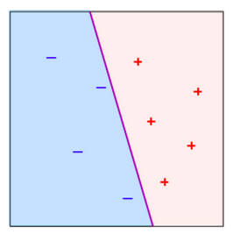
Visualizing the separator
+ : dogs
- : cats
Purple line:
the separator or previously „model“

Slide 7
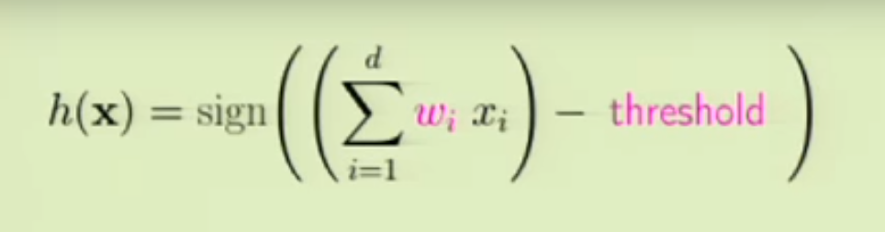
Supervised Learning

Slide 8
Supervised Learning
Weighted sum of attributes:

Slide 9
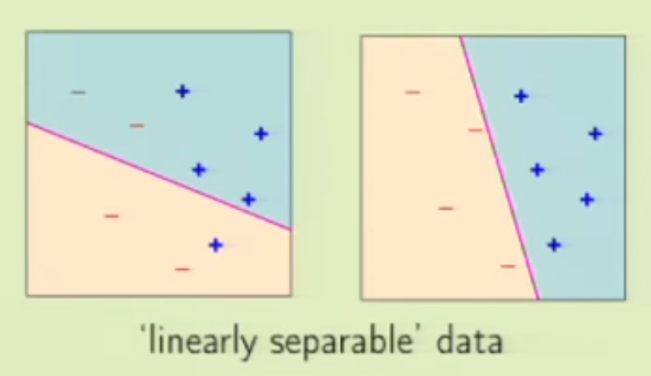
Supervised Learning
Weighted sum of attributes
Threshold Function – Binary Output
Weights and threshold together form a separator

Slide 10
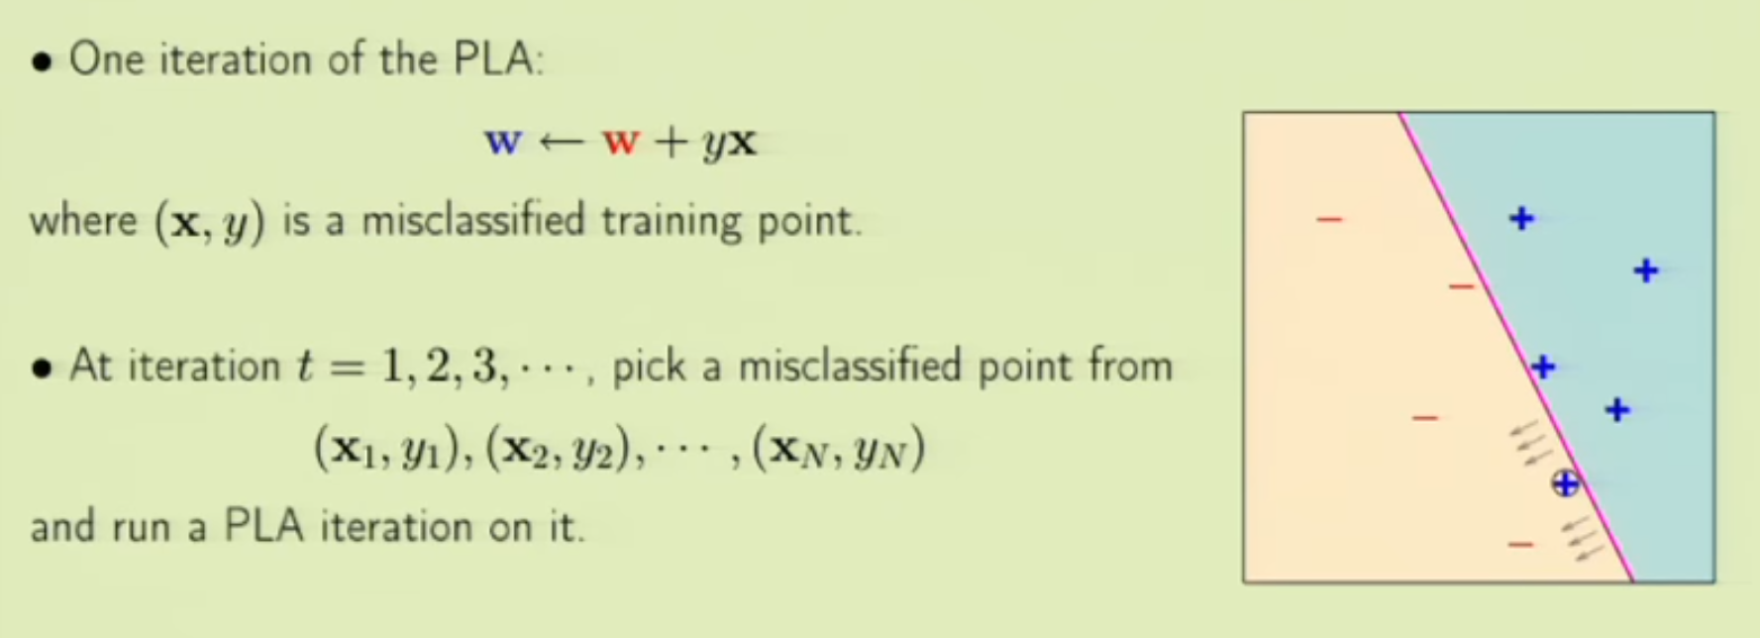
Supervised Learning
Vorstellung Mathematisch

Slide 11
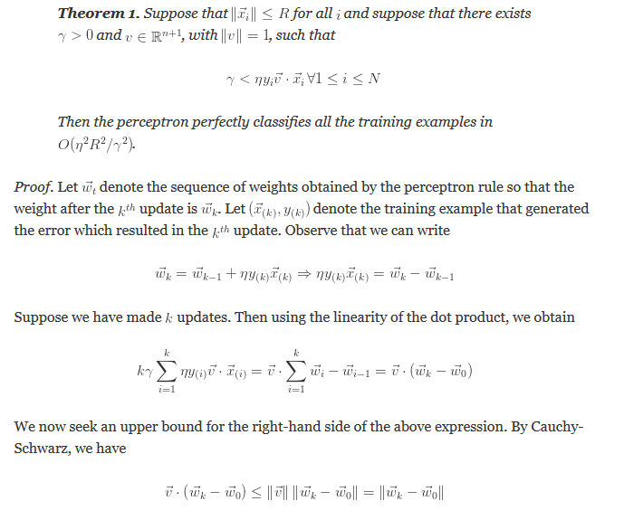
Perceptron Algorithm
Unserer Anpassung des Algorithmus
Notes:
Hier Idee zur Parallelisieren oder weiter unter ?

Slide 12
Class diagram
Notes:
Einzelne Klassen kurz vorstellen, Logik explizit vorstellen

Slide 13
Perceptron Algorithm
Unserer Anpassung des Algorithmus
Notes:
Hier Idee zur Parallelisieren oder weiter unter ?

Slide 14
Going Parallel
dsdsdsdsd
Notes:
Idee der Parallelisierung vorstellen

Slide 15
Parallele Teil des Programms
dsdsdsdsd
Notes:
Idee der Parallelisierung vorstellen

Slide 16
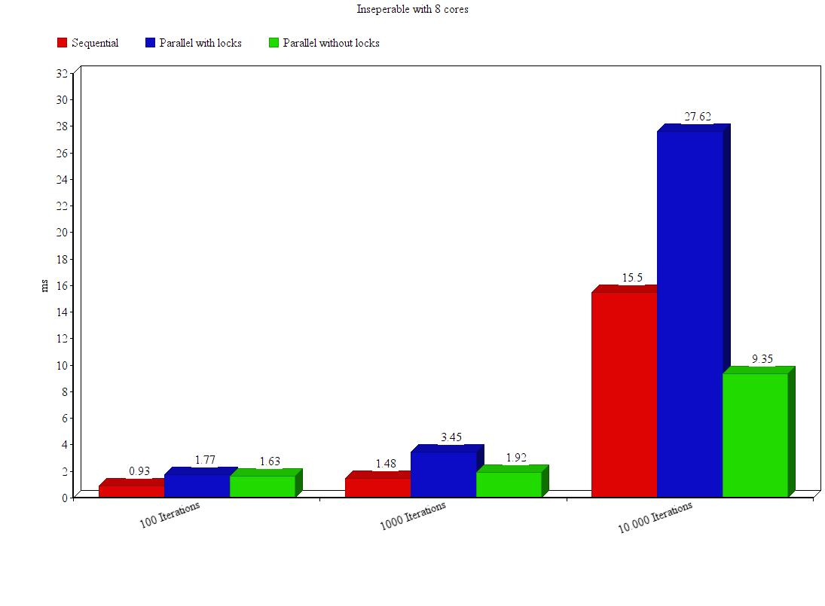
Benchmarks
Average of 100 calls
Tested with 100 Points
Notes:
Idee der Parallelisierung vorstellen

Slide 17
Benchmarks
Overhead caused by Java Threads
Notes:
Idee der Parallelisierung vorstellen

Slide 18
Benchmarks
Algorithm is by its nature not efficiently parralellizable:
All threads share „weights“ variable causing race conditions
Synchronized blocks + thread overhead hinder better performance
Notes:
Idee der Parallelisierung vorstellen

Slide 19
Parallel Problems
dsdsdsdsd
Notes:
Idee der Parallelisierung vorstellen

Slide 20
Conclusion
Reflection on what this research aimed for:
Efficient parallel implementation of the perceptron learning algorithm
Reflection on research and methods:
We had troble with the software that was to be used (OMP4J)
So we could not work the way we planned to
Result is not satisfactory as a consequence
Reflection on the final result:
goal was not achieved, algorithm with JAVA threads caused race conditions
Synchronization required
no speedup can be achieved
Whats to be discussed :
Better with C-style preprocessor OpenMP?
Notes:
Idee der Parallelisierung vorstellen

Slide 21
Sources
Dsdsdsdsd
Notes:
Idee der Parallelisierung vorstellen

